Slide 1
APOLOGETICS
IN ONE LESSON
almost
Ai1L.net
Lesson 24
Jesus Died by Crucifixion; His Disciples Believed He Resurrected

Slide 2
Read the non-Christian accounts of Jesus’ death by crucifixion
1

Slide 3
“...one is obliged to say, 'Here was a man. This part of the tale could not have been invented.'”
H.G. WELLS The Outline of History, Volume 1 (page 497)

Slide 4
Read the Gospels accounts of Jesus’ death by crucifixion
2

Slide 5
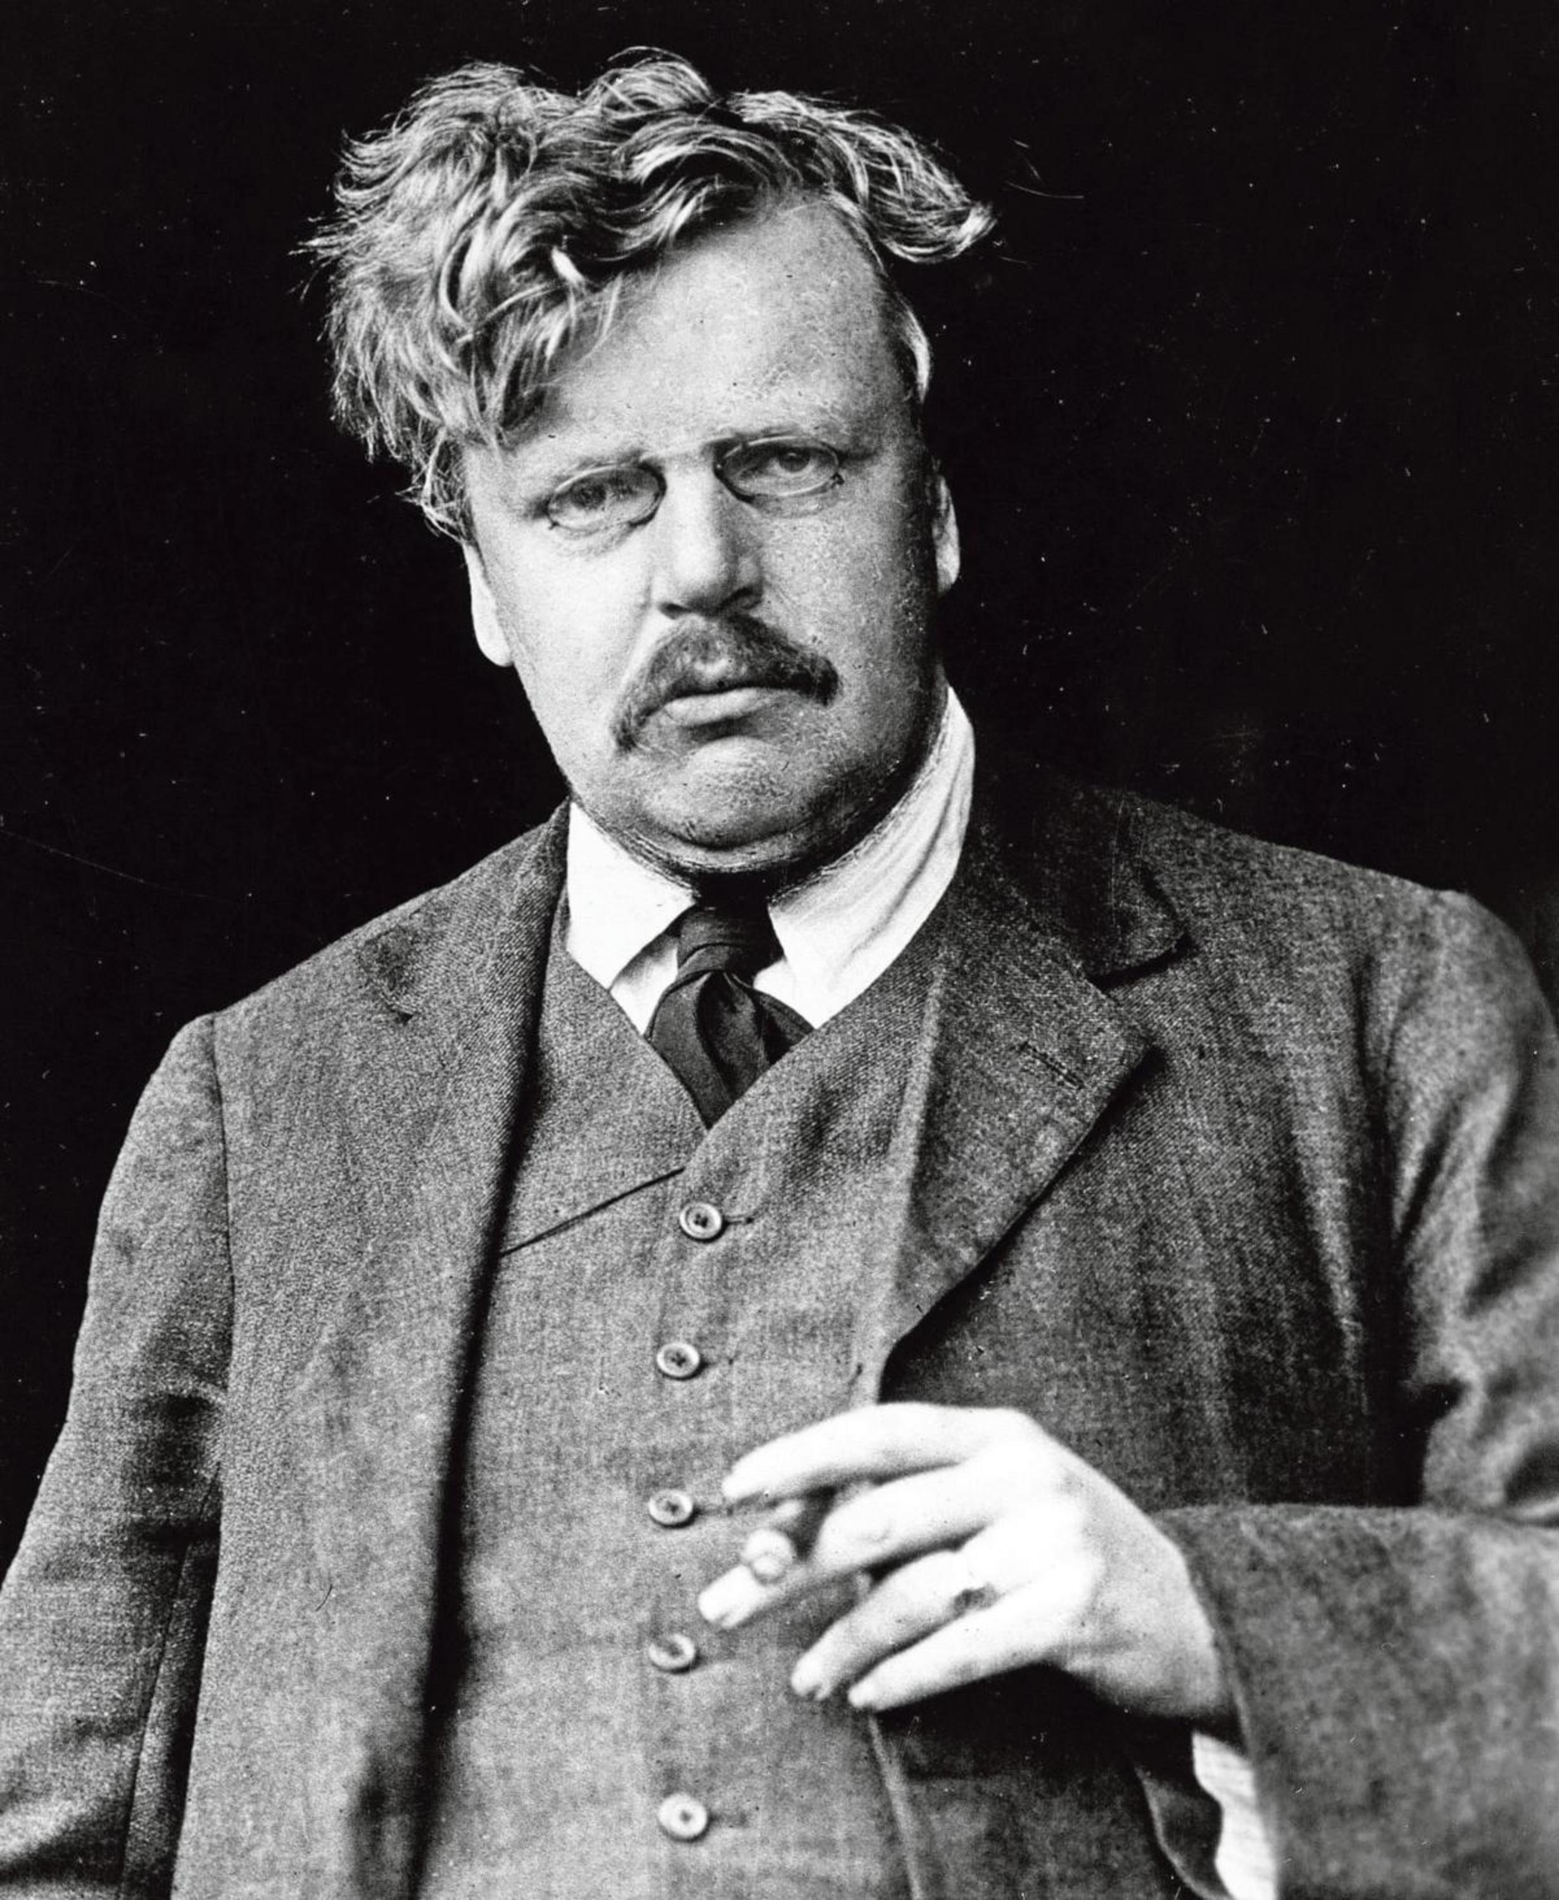
“This is the sort of truth that is hard to explain because it is a fact; but it is a fact to which we can call witnesses”
G.K. CHESTERTON The Everlasting Man

Slide 6
Document the claims of the early witnesses of Jesus’ resurrection
3

Slide 7
Which Apostles were martyred?
Peter
Paul
James, the Brother of Jesus
John, son of Zebedee
Thomas
Andrew
James, son of Zebedee
Philip
Bartholomew
Matthew
James, son of Alphaeus
Thaddeus
Simon the Zealot
Matthias
Source: “The Fate of the Apostles” by Josh McDowell
To be considered martyred, the person be killed due to being a Christian
This list includes those that are not specifically part of the Twelve (like James)

Slide 8
“﻿not a shred of evidence exists that any apostle wavered in or recanted his faith—excluding Judas.”
SEAN MCDOWELL The Fate of the Apostles (page 261)

Slide 9
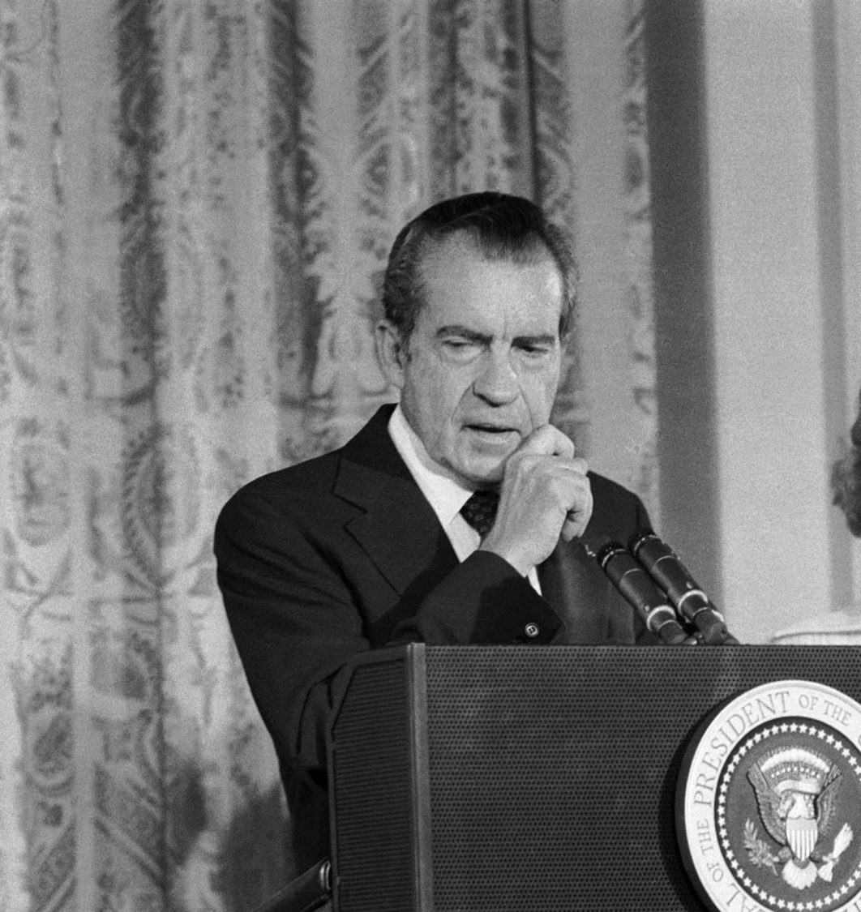
“The real cover-up, the lie, could only be held together for two weeks”
CHUCK COLSON (former Nixon Aide) Breakpoint with Chuck Colson, 2002/03/29

Slide 10
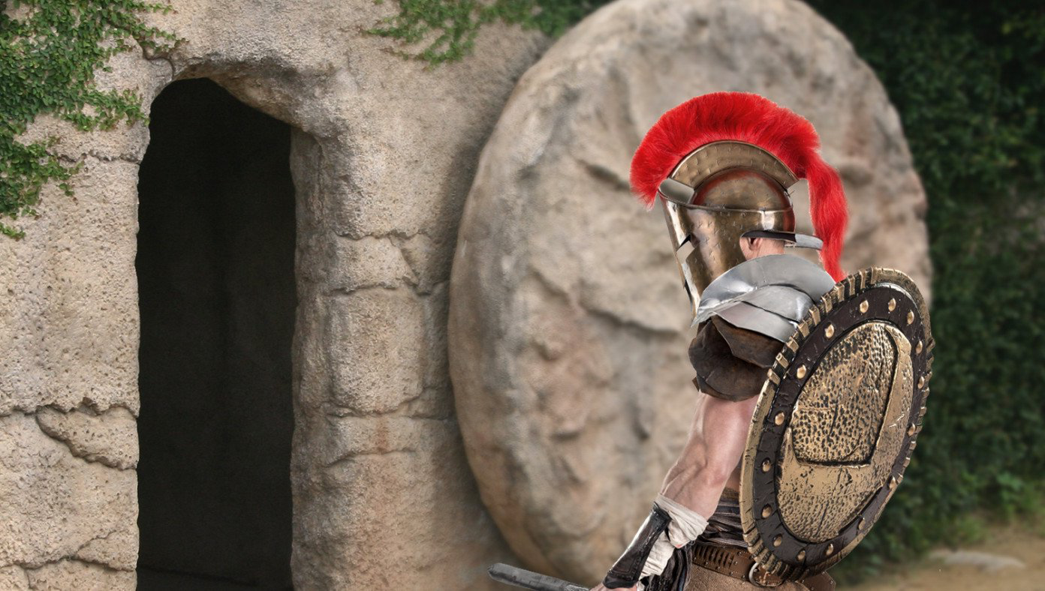
Roman Authorities Investigating Jesus For Violating Stay-In-Tomb Order
BABYLON BEE April 12th, 2020 http://bit.ly/Ai1LStayInTomb

